Slide 1
Digital UX

Slide 2
Design Thinking
Process
  Understand
    Google about the problem to get information before empathizing
    Empathize – Conduct research to develop an understanding of your user
      What is the problem
      What is the pain points – Use google to get some information
      See – User Research Methods
      What is the user during the exercise
        Do
          Actions the user Takes
        Feel
          Emotional
          State
        Think
          Thinking through the experiences Possible reluctant to share
        Say
          Says out loud in an interview
    Define
      Combine all your research and observe where your user’s problems exist
      Persona : A representation of the users to find patterns : Define Goals, Needs, Motivation, frustration ( Why is it not working )
      Journey Map – Map a take,persona,routine ouf the person to highlight where there are pain point
      Problem Statement is the output of the Define Section

Slide 3
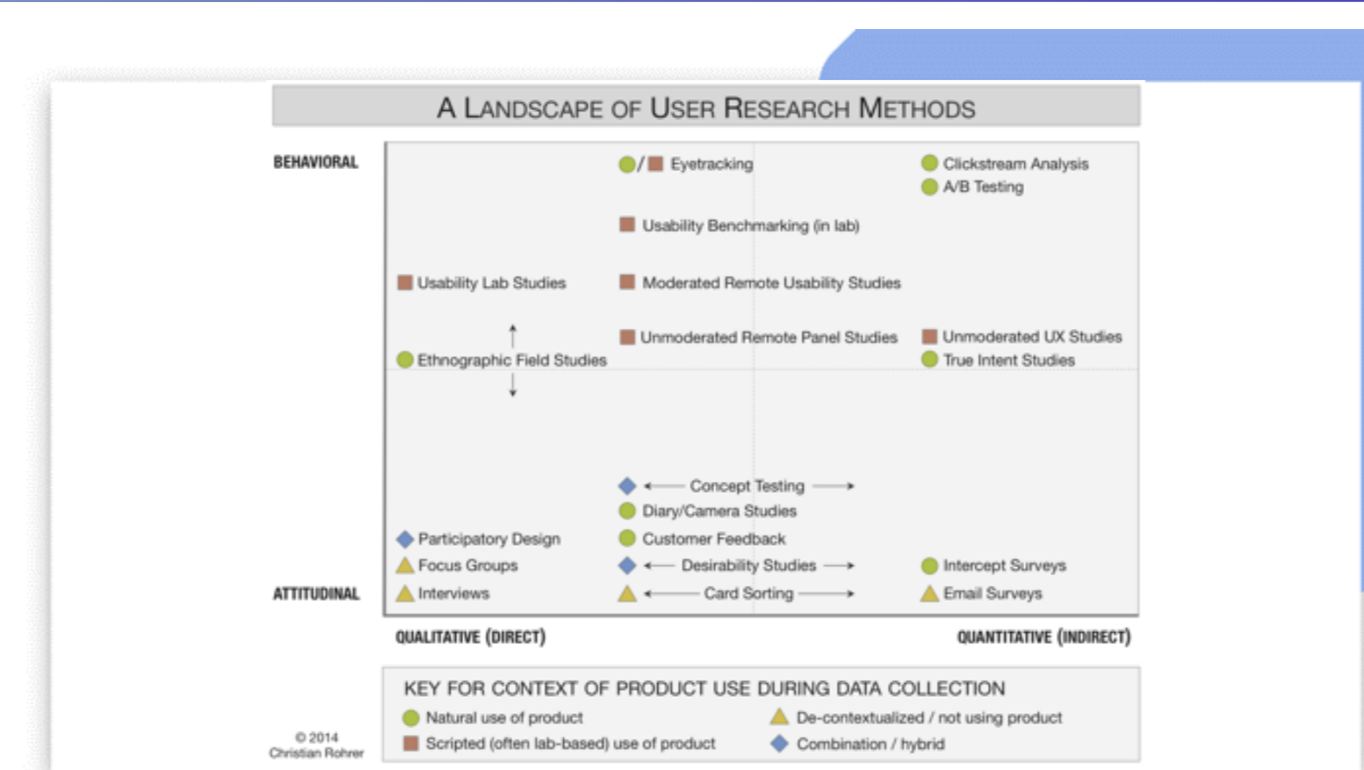

Slide 4
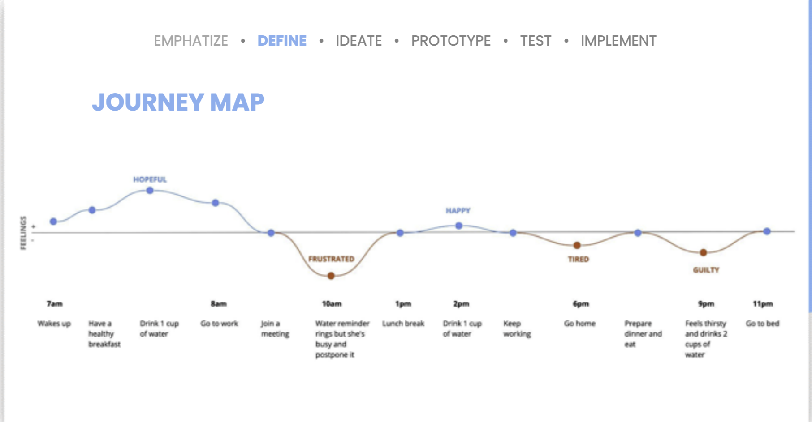

Slide 5
Explore
  Ideate – Generate a range of crazy creative ideas
    HMW – Reframe problems into insights or questions
      Go back to the person and validate the insights
    Brainstorm – Aiming for quantity not quality
      Bad ideas could trigger good ideas
    Competitors – Understand the state of the market
  Prototype
    Select a few actions from ideate
    Build a real, tactile representation of your ideas
    Tool : Userflow, Lo-fi wireframes
    Hi5
      Apply Styling ( anything that will make the prototype ready )
    Figma – A tools for wireframes
    Information Architecture – Is the GUI good – heirarchery of screens, logical, look
      Mid frame – keep in grey scale don’t want to worry about style definition the way the users perceived ( testing navigation and architecture
    Mood Board – Visual representation of the product’s Look & feel. Show the intention behind the visual design decisions
    Style Guide – A documentation of all UI Elements from colors and typography to cards, buttons and templates
Materialize
  Test
    Return to your users for feedback
  Implement
Design thinking is a human centered approach to innovation that draw from the designer’s toolkit to integrate the needs of the people, the possibilities of technology and the requirements for business success
User Centric

Slide 6
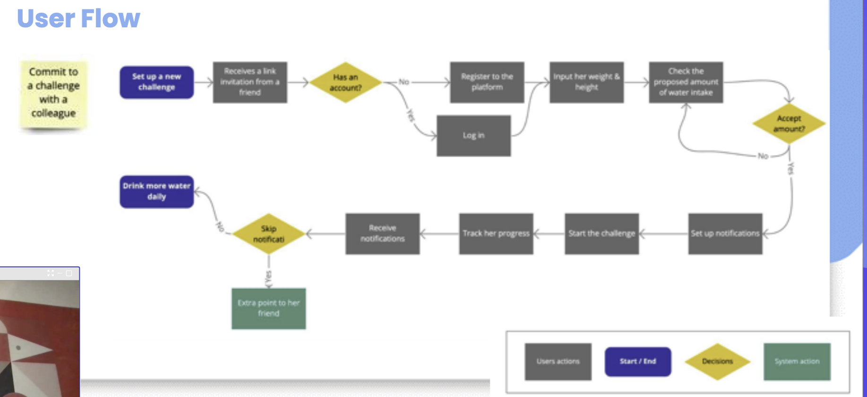

Slide 7
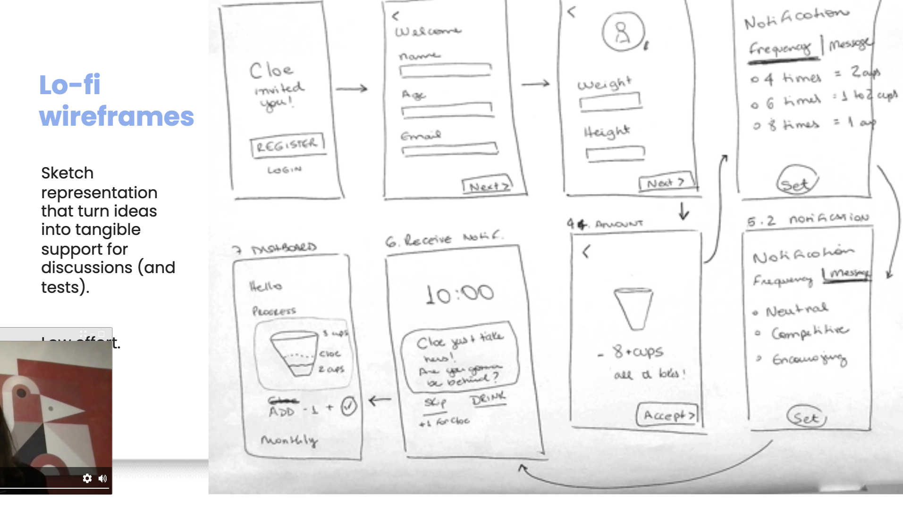

Slide 8
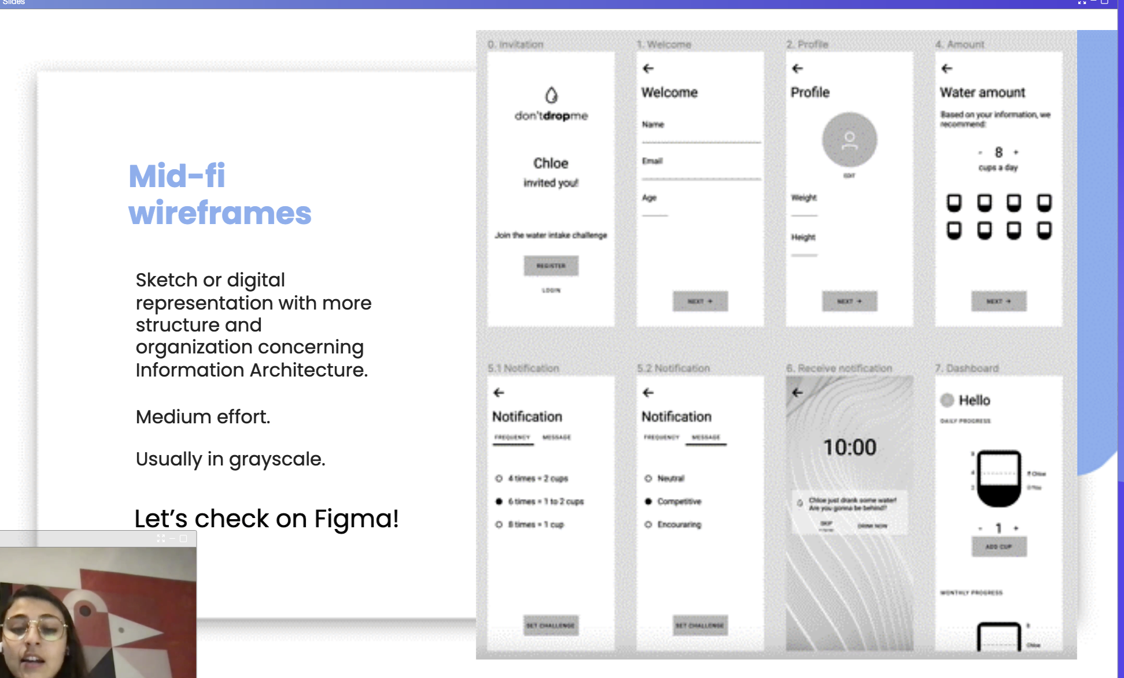

Slide 9
Materialize
  Test
    Concept – Testing -- Validating your idea with low effort
      Test low effort wireframes
      Ask the user about the ideas and how they feel about it.
    Usability Testing – Validating information Architecture, Navigation and user flow
      Interactive prototype
      Analyze how they perform.
    Desirability Testing – Understand the emotional reaction regarding your prototype look & feel
      Apply hi effort to test the look and feel.
      Already know the navigable is good.
  Return to your users for feedback
Implement
  Prepare document for
    Desirability – Is it good for the users
    Feasibility – Do we have the technology
    Viability – Is it cost effective
Trying to make it more pragmatic

